Slide 1

ANNOUNCEMENTS
May 11, 2025
Mission Sunday

Slide 2
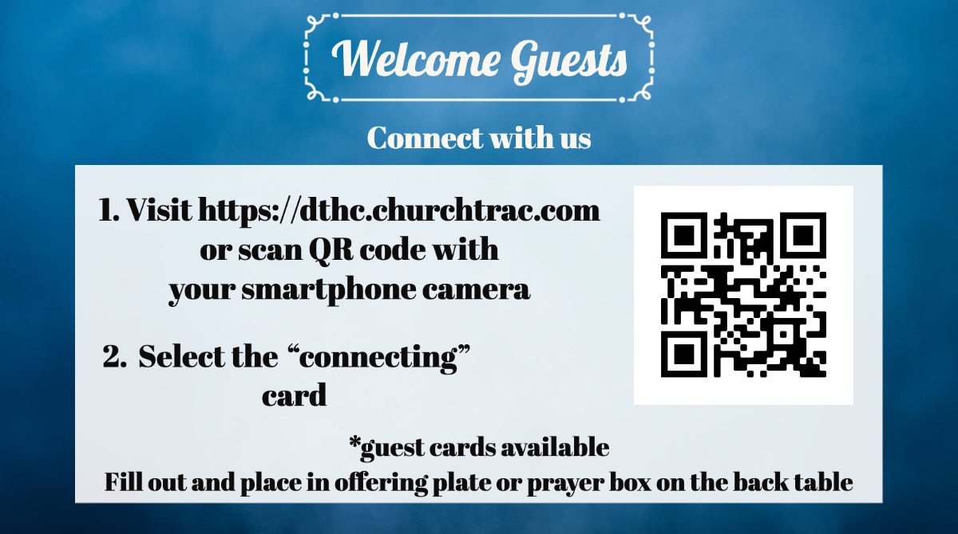

Slide 3
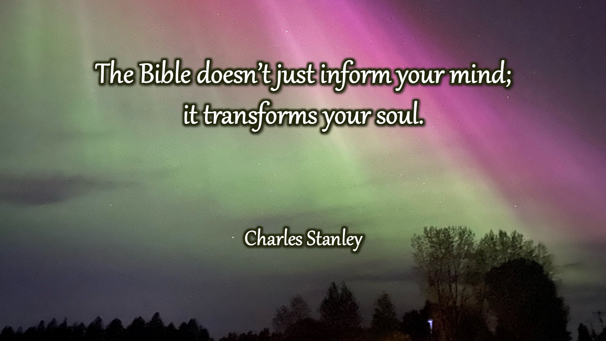

Slide 4


Slide 5


Slide 6

Next Meeting: Monday May 19

Slide 7


Slide 8


Slide 9


